Slide 1
Predicting Flight Delays
Swapnali and Hari Mathala
June 18, 2016

Slide 2
Identifying the Problem
Approximately 20% of airline flights are delayed or cancelled, costing travelers over 20 billion dollars in lost time and money. Many factors affect flight delays including air traffic control backups, equipment delays, and weather. Our goal was to leverage the massive amount of data available on flight punctuality and to forecast by what time the flight will be delayed.

Slide 3
Analyzing Available Data Source
Took a small sample snapsot (5900609 flights from November 2013 to October 2014 ).
CRS_DEP_TIME CARRIER DEP_TIME DEST DISTANCE FL_DATE FL_NUM ORIGIN 1 1455 OH 1455 JFK 184 37987 5935 BWI 2 1640 DH 1640 JFK 213 37987 6155 DCA 3 1245 DH 1245 LGA 229 37987 7208 IAD 4 1715 DH 1709 LGA 229 37987 7215 IAD 5 1039 DH 1035 LGA 229 37987 7792 IAD

Slide 4
Analyzing Available Data Source
Weather DAY_WEEK DAY_OF_MONTH TAIL_NUM Flight.Status 1 0 4 1 N940CA ontime 2 0 4 1 N405FJ ontime 3 0 4 1 N695BR ontime 4 0 4 1 N662BR ontime 5 0 4 1 N698BR ontime

Slide 5
Analyzing Available Data Source
Year
Month
DayofMonth
DayofWeek
UniqueCarrier
OriginAirportID
DestAirportID
CRSDepTime (the local time the plane was scheduled to depart)
CRSArrTime (the local time the plane was scheduled to arrive)
ArrDelay (how early/late the plane was at its final destination in minutes: our target variable)
Distance (how far did the plane travel for the route)
CRSElapsedTime (the scheduled difference between departure and arrival)

Slide 6
Analyzing Available Data Source
The goal here is to predict the flight delay time in number of minutes
Logistic regression provides us with a probability of belonging to one or the two cases (delayed or ontime). Since probability ranges from 0 to 1, we will use the 0.5 cutoff to determine which bucket to put our probability estimates in. If the probability estimate from the logistic regression is equal to or greater tha 0.5 then we assign it to be ontime else it’s delayed

Slide 7
Exploratory Data Analysis:
Please note the following:
CO: Continental
DH: Atlantic Coast
DL: Delta
MQ: American Eagle
OH: Comair
RU: Continental Express
UA: United
US: US Airways
Based on Day of the Week effect. We see that Mondays and Sundays have the most delayed flights and Saturdays have the least. Note: 1 is Monday and 7 is Sunday.

Slide 8
Exploratory Data Analysis:
The next step in predictive analytics is to explore our underlying data. Let’s do a few plots of our explanatory variables to see how they look against Delayed Flights.
Carriers Distribution in the Data Set
Carrier | Count | Percentage
CO | 94 | 4.3%
DH | 551 | 25%
DL | 388 | 17.6%
MQ | 295 | 13.4%
OH | 30 | 1.4%
RU | 408 | 18.5%
UA | 31 | 1.4%
US | 404 | 18.4%

Slide 9
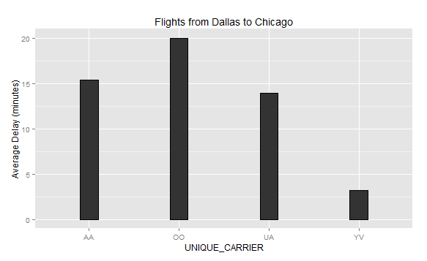
Exploratory Data Analysis:
There are only four carriers that offer direct flights from Dallas to Chicago in the database. Data frame has each carrier listed with a two letter code.

Slide 10
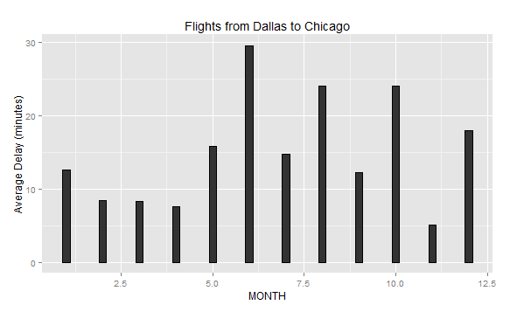
Exploratory Data Analysis:
June seems to be the worst month for this route. If you combine increased summer vacation travel and thunderstorms over north Texas, this makes sense. The best month seems to be November

Slide 11
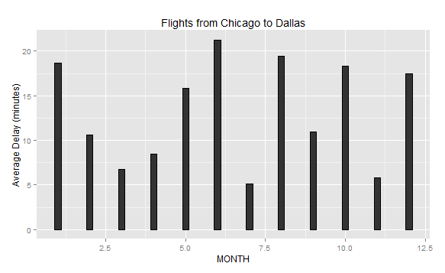
Exploratory Data Analysis:

Slide 12
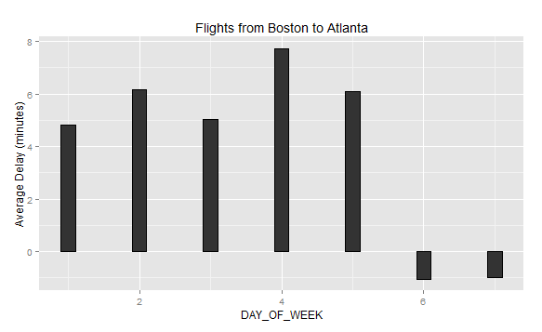
Exploratory Data Analysis:
Note that the day of week starts on Monday (so Monday = 1, Tuesday = 2, etc.). We can see that Saturday and Sunday are the best days to fly if you want to be on time, with Thursday having the most problems.
Next, let’s look to see if having a flight closer to a holiday causes late arrivals for our Boston to Atlanta route.

Slide 13
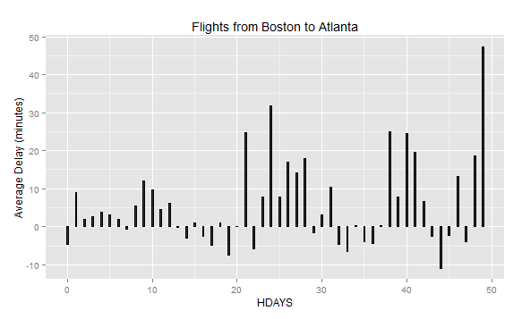
Exploratory Data Analysis:
There didn’t seem to be much of a clear pattern here. It is possible this feature is a good predictor for only some flights but not others. Perhaps looking at the departure hour will give a stronger signal.

Slide 14
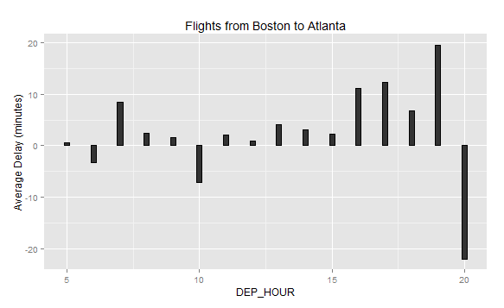
Exploratory Data Analysis:

Slide 15
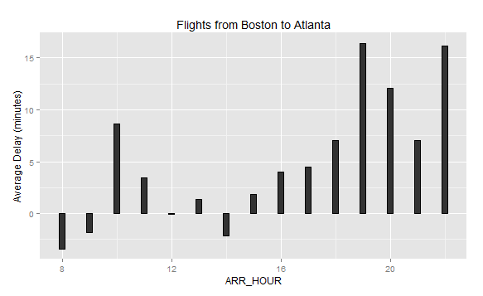
Exploratory Data Analysis:
The scheduled arrival hour is a better predictive feature than departure hour for this route. With a few minor exceptions, flights arrive increasingly late further along in the day the flight is scheduled to arrive.

Slide 16
Data Transformation
One of the main steps in the predictive analytics is data transformation. Data is never in the way you want them. One might have to do some kind of transformations to get it to the way we need them either because the data is dirty, not of the type we want, out of bounds, and a host of other reasons

Slide 17
Model Building:
Since processing large number of training examples (nearly 6 million!) would be computationally infeasible tree-based method is not implemented
We rely on a regression model that scales more easily and is better suited for online learning: ridge regression.

Slide 18
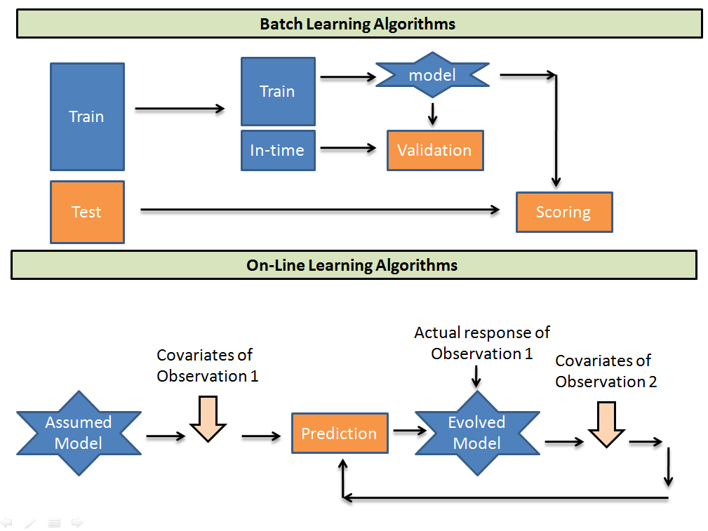
On-line learning algorithms take an initial guess model and then picks up one-one observation from the training population and recalibrates the weights on each input parameter.

Slide 19
Regression Model to Predict Flight Delays
Regression model to predict how late a flight will be:
the SGD (or Stochastic Gradient Descent) : It can accept sparse matrices and is recommended for greater than 10,000 training examples.
Essentially, the model is updating the weights of a input parameter regress by inputting one training example at a time instead of all of them in a single batch. This greatly reduces the amount of memory you need when running the model and works well for models that constantly need updates (such as streaming data).

Slide 20
Regression Model to Predict Flight Delays
 | Unnamed: 0 | MONTH | DAY_OF_MONTH | DAY_OF_WEEK | UNIQUE_CARRIER | ORIGIN_AIRPORT_ID | DEST_AIRPORT_ID | ARR_DELAY | CRS_ELAPSED_TIME | DISTANCE | HDAYS | ARR_HOUR | DEP_HOUR | CARRIER_CODE
0 | 1 | 1 | 1 | 3 | AA | 12478 | 12892 | 13 | 385 | 2475 | 0 | 12 | 9 | 2
1 | 2 | 1 | 2 | 4 | AA | 12478 | 12892 | 1 | 385 | 2475 | 1 | 12 | 9 | 2
2 | 4 | 1 | 4 | 6 | AA | 12478 | 12892 | 59 | 385 | 2475 | 3 | 12 | 9 | 2
3 | 5 | 1 | 5 | 7 | AA | 12478 | 12892 | 110 | 385 | 2475 | 4 | 12 | 9 | 2
4 | 6 | 1 | 6 | 1 | AA | 12478 | 12892 | -8 | 385 | 2475 | 5 | 12 | 9 | 2

Slide 21
Regression Model to Predict Flight Delays
Training The Model
Tried some cross-validation to see which alpha parameter is the best given,used GridSearch
GridSearchCV(estimator, param_grid, scoring=None, fit_params=None, n_jobs=1,iid=True, refit=True, cv=None, verbose=0, pre_dispatch='2*n_jobs', error_score='raise')

Slide 22
Function Implementation
Now that we have our regression model trained and ready, it’s time to design a function that utilizes it.
The function will allow the user to enter all of the information about their flight and return the predicted delay time in minutes. The inputs will be:
Origin Airport
Destination Airport
Carrier
Scheduled Departure Hour
Scheduled Arrival Hour
Month
Day
Day of Week

Slide 23
Function Implementation

Slide 24
Ideas for Improvement and Summary
Allow integration of weather forecast data into the model but only if the user was a few days away from the flight’s departure
Try creating separate models for each flight path to see if that improves the accuracy of our prediction
Make the delay_prediction function more robust with fewer potential bugs. There are certain edge cases that could cause issues, such as an airline input into the function not being at the airport in question (Southwest, for example, tends to fly at smaller airports only)
The HDAYS variable will need to be updated for each year used, as some holidays are not on the same date every year. In the program’s

Slide 25
Thanks!!!

